Slide 1
CSS7000 - INTERNSHIP Review- Presentation Bharat Study Chatbot: An Enterprise Based AI Study Companion
Student Details
Name | ROHAN BLAZEY
Roll No | 20241CAI0078
Section | 5CAI02
Under the Supervision of,
Asst. Prof. John Bennet J
Assistant Professor
Presidency School of Artificial Intelligence & Advanced Computing
Presidency University
Name of the Program: AI Summer Internship Program
Name of the HoD: Prof. Zafar Ali Khan
Name of the Program Internship Coordinator: Mr. Anandan B
Name of the School Internship Coordinator: Dr. Geetha Arjunan

Slide 2
Content
About Company
Working domain, technology
Overview
Objectives of the work
Specifications
Representations
Challenges Faced in Internship
Github Link

Slide 3
About Company
NVIDIA Accelerated AI Centre of Excellence
NVIDIA - Leading AI and GPU Computing Company
Focus: Accelerating AI, HPC, and Deep Learning
NVIDIA H200 GPU: Advanced AI Accelerator with Hopper Architecture
Applications: ML, DL, Computer Vision, NLP, Generative AI
Mission: Supporting next-generation AI infrastructure and education

Slide 4
Working domain, technology
Domain: Educational AI & Natural Language Processing
Enterprise-Grade Retrieval-Augmented Generation (RAG)
Hybrid Search Pipeline combining Semantic Vectors (ChromaDB) and Lexical Matching (BM25)
Real-Time API Orchestration for Current Affairs Aggregation
Neural Machine Translation across 12 Regional Indian Languages
Interactive Web Application Development
CUDA & GPU-Accelerated Computing

Slide 5
Overview
Project: Bharat Study Chatbot – An AI Study Companion
Team Structure: Individual Project - Rohan Blazey
Mentorship: NVIDIA AI Centre of Excellence
Supervisor: Asst. Prof. John Bennet J
Technologies: Next.js, FastAPI, Python, ChromaDB, Hugging Face
Infrastructure: The infrastructure operates as a zero-cost Edge AI system running entirely on a local laptop CPU and Wi-Fi network, with cross-device accessibility

Slide 6
Objectives of the work
Automate educational assessment workflows
Provide absolute factual determinism by eliminating AI hallucinations in competitive exam preparation (UPSC, NDA, GATE).
Ensure computational sovereignty and zero recurring costs by utilizing local, open-source LLMs (Llama-3.2-3.8B).
Bridge India's digital and linguistic divide via a low-latency, 12-language localization pipeline.
Deploy a universally accessible Progressive Web Application (PWA) to serve resource-constrained mobile hardware in rural demographics.
Demonstrate practical AI/ML application in EdTech

Slide 7
Specifications
Frontend Specifications
Framework: Next.js (React.js) with App Router
Language and Styling: TypeScript / JavaScript and CSS
Native Web APIs: Web Speech API (for Text-to-Speech audio generation)
Backend Specifications
Framework: FastAPI (High-performance, asynchronous REST API)
Language: Python 3.x
Server: Uvicorn (ASGI web server)
AI & Machine Learning Specifications
Large Language Model (LLM): Meta Llama-3 (8 Billion Parameters, Instruct-tuned)
Inference Engine: GPT4All Python Bindings (Hardware-agnostic, edge-computing engine)
Vector Database: ChromaDB
Document Processing: PyPDF2 for text extraction
GPU Implementation Retrieval (RAG) Layer: Embedding models with GPU memory alongside the LLM

Slide 8
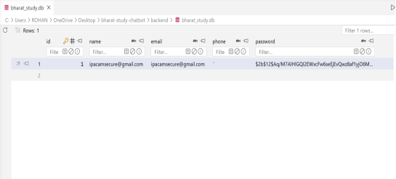
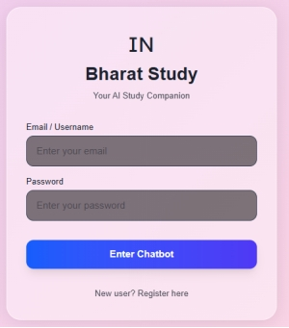
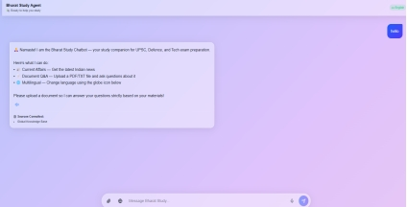
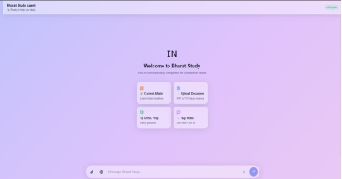
Representations

Slide 9
Challenges Faced in Internship
Learning Complex NLP & Transformer Models
Mastering CUDA & GPU Computing for AI
Understanding Kubernetes Container Orchestration
Overcoming the limitations of linear "Naive RAG" pipelines by developing robust Hybrid search algorithms.
Resolving silent, cascading API failures caused by environment variable mismatches between local and production deployments.
Bypassing rate-limiting bottlenecks from third-party news APIs via redundant failover orchestration.

Slide 10
Github Link
https://github.com/ROHAN-BLAZEY/bharat-study-chatbot

Slide 11
Q&A

Slide 12
Thank you !!

